Slide 1
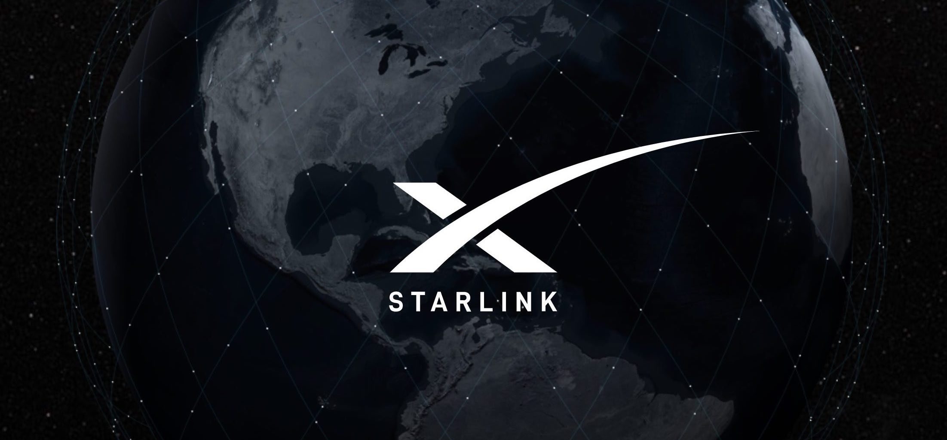

Slide 2
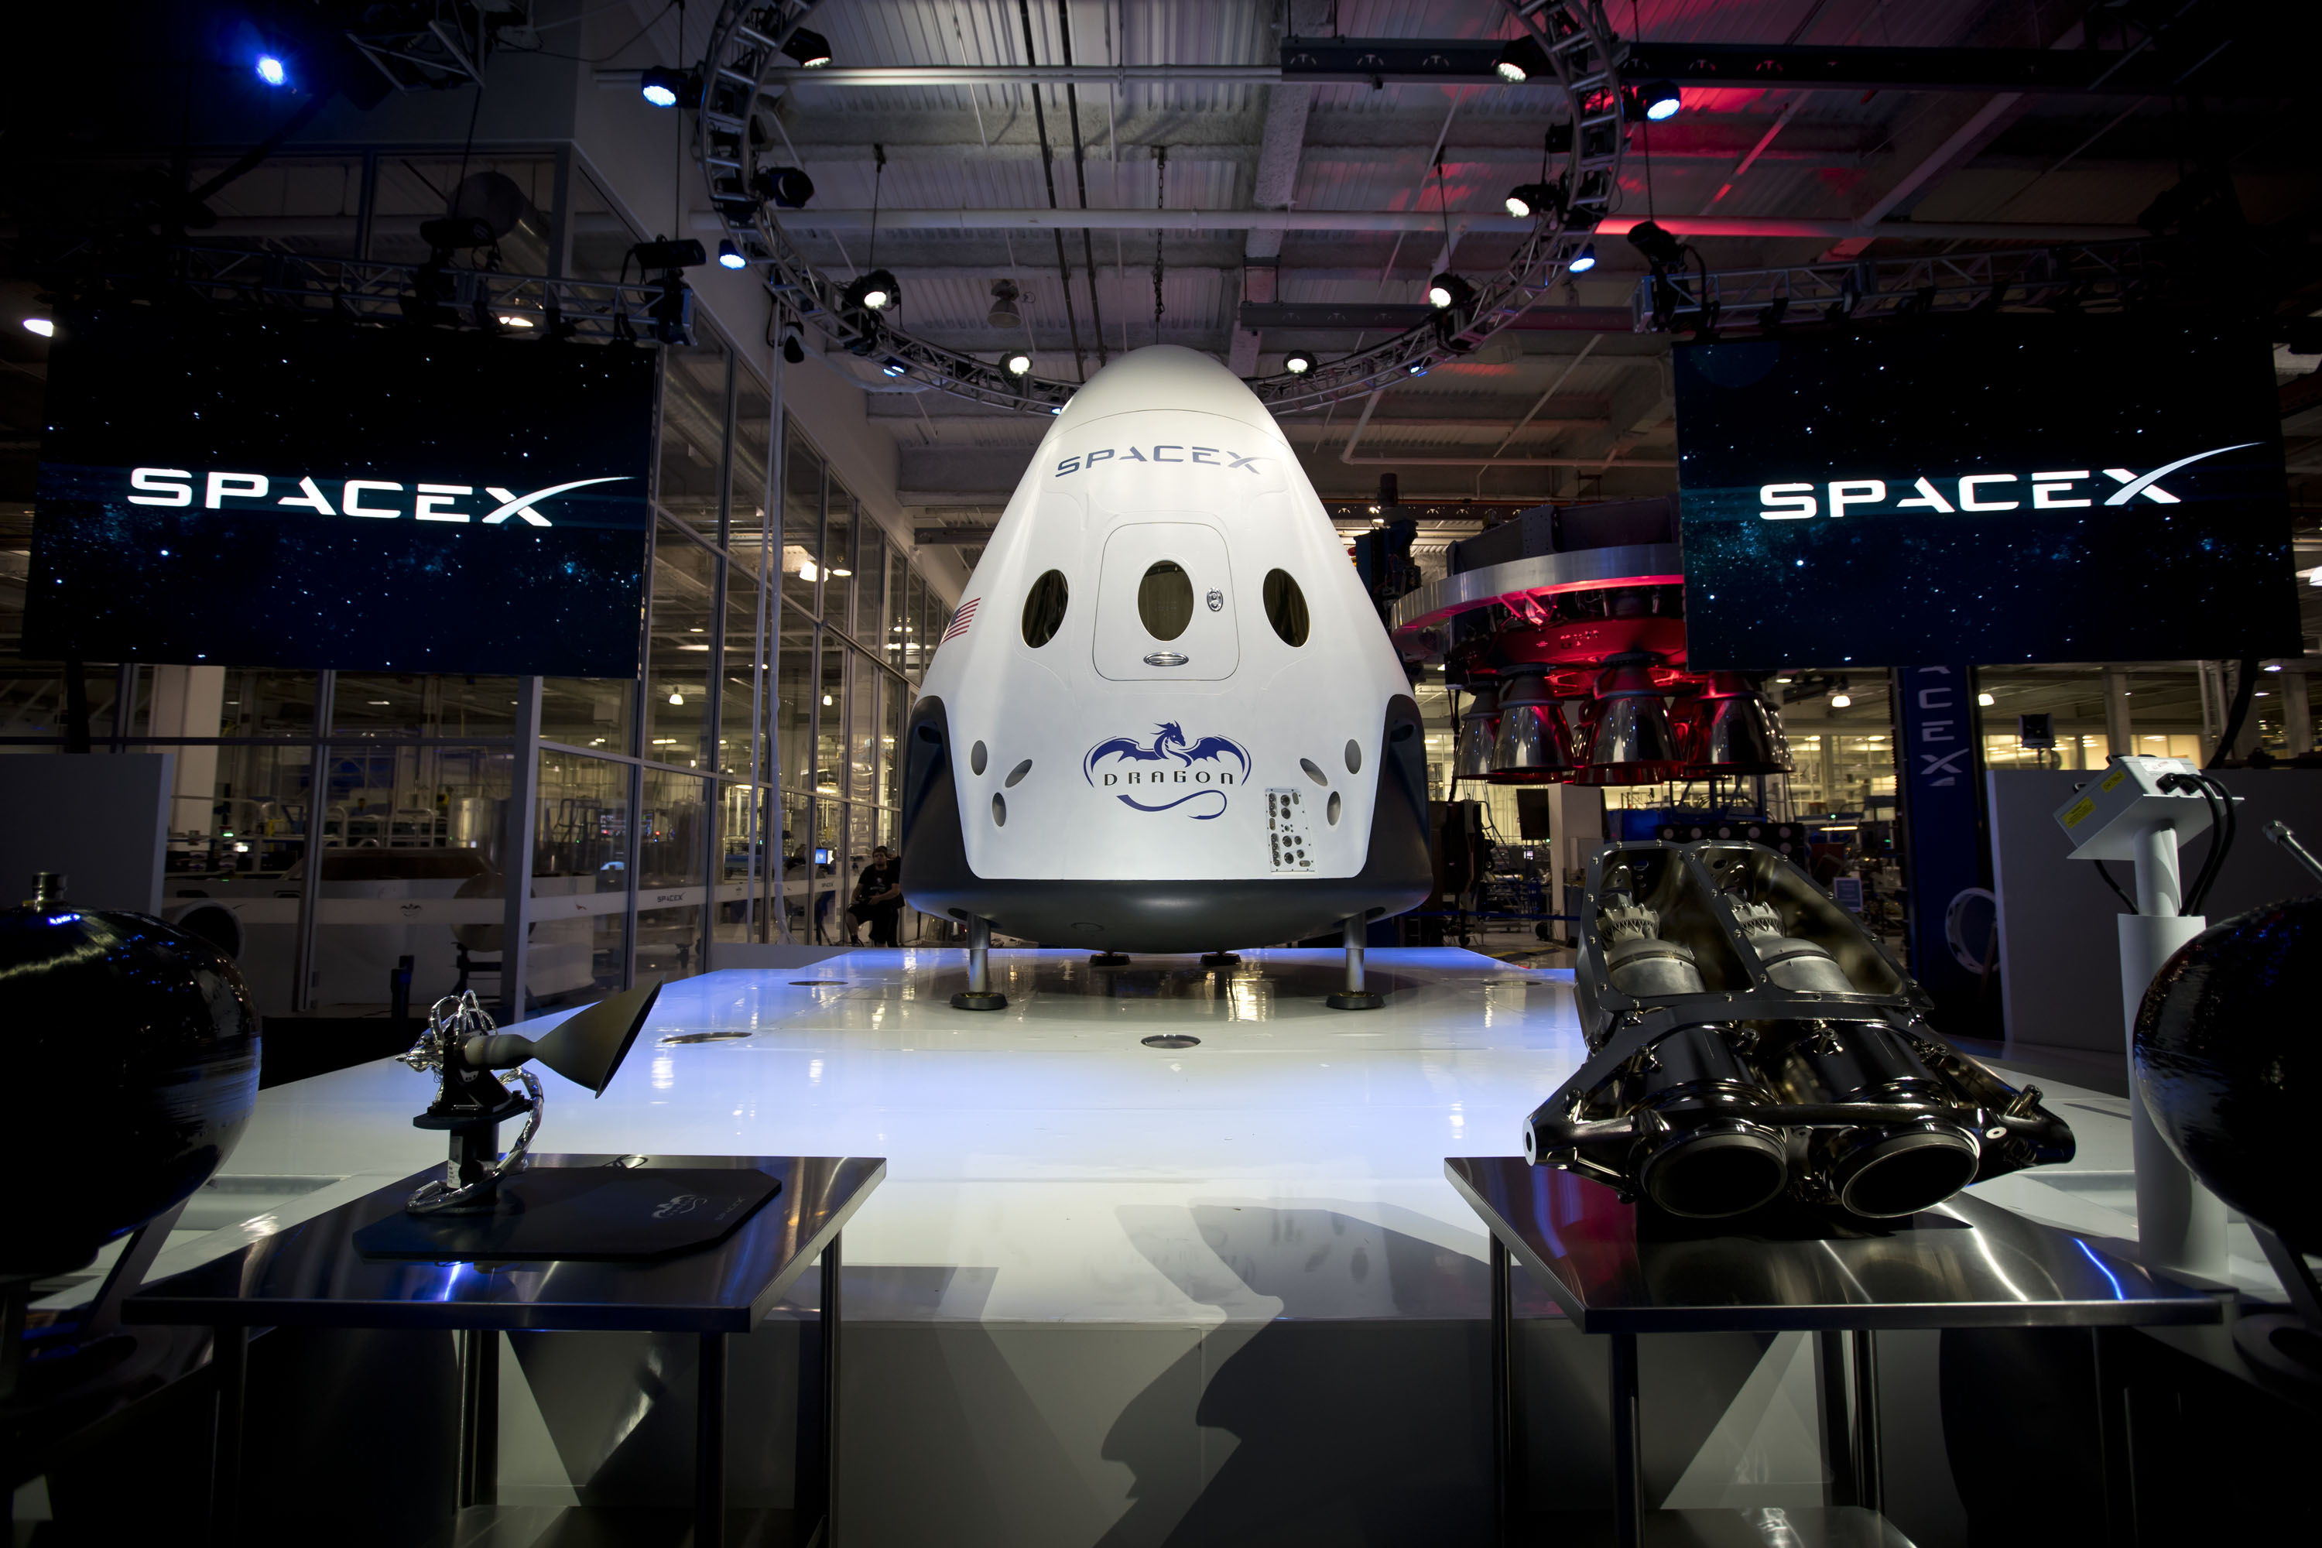
1

Slide 3

2
Who is Elon musk ?
Elon Reeve Musk is a South African-born American entrepreneur and businessman who founded X.com in 1999 (which later became PayPal), SpaceX in 2002 and Tesla Motors in 2003. ... Musk made headlines in May 2012, when SpaceX launched a rocket that would send the first commercial vehicle to the International Space Station.

Slide 4
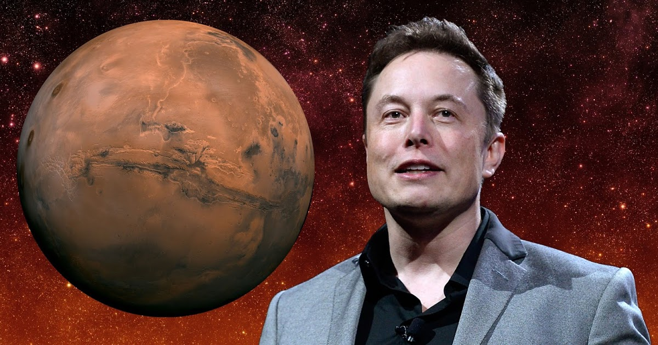
Here comes million dollar man
3
This Photo by Unknown Author is licensed under CC BY

Slide 5
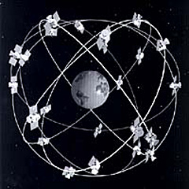
4
What is a Satellite Constellation?
A group of artificial satellites working in concert, with coordinated ground coverage, operating together under shared control.

Slide 6
Do any such constellations exist?
The Iridium Satellite Phone System is the only provider of truly global, truly mobile satellite voice and data solutions with complete coverage of the Earth. It launched 77 satellites between 1997 & 2002.with a commercial satellite phone service live in March 2001.
Iridium has recently replaced its existing 60 satellite constellation by sending 75 Iridium NEXT satellites into space on a SpaceX Falcon 9 rocket over 8 different launches.
On January 11th, 2019 the final 10 Iridium NEXT satellites were delivered to low earth orbit (780km, 480 miles).

Slide 7
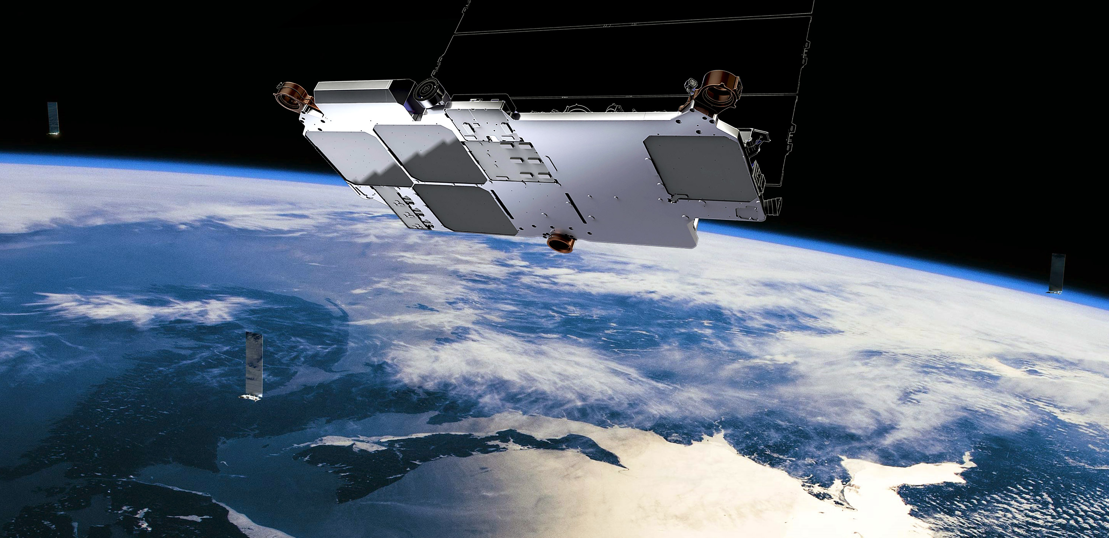
Star link (satellite constellation)
How many Starlink satellites are there?
Currently there are 2,000 operational satellites in orbit around Earth, according to the latest figures from the European Space Agency, and the completed Starlink constellation will drastically add to that number.

Slide 8
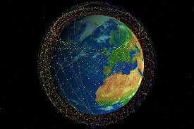
What will Starlink do?
Starlink could bring cheap, fast internet to remote areas, airplanes, ships, and cars, plus make international teleconferencing and online gaming nearly lag-free.

Slide 9
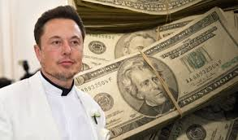
How much will SpaceX Starlink cost?
Starlink is expected to cost at least $10 billion to develop. The company says it's currently on strong financial footing. But SpaceX is privately held, so there isn't a lot of information out there about how money moves through the company

Slide 10
What is the purpose of Starlink?
The goal is to finish the project in 2027, thereby blanketing the Earth with high-speed, low-latency, and affordable internet access. Even partial deployment of Starlink would benefit the financial sector and bring pervasive broadband internet to rural and remote areas.

Slide 11
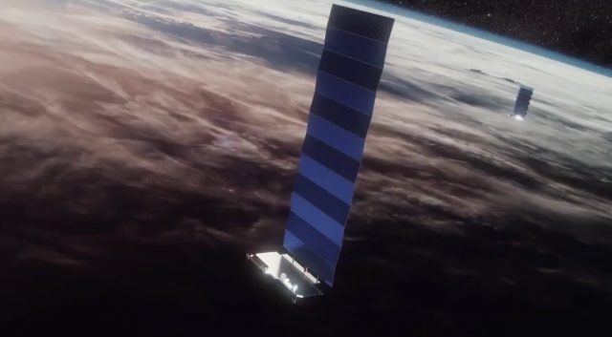
How large is a Starlink satellite?
SpaceX launched the first 60 satellites for an internet constellation that could ultimately number 12,000 on a Falcon 9 rocket
Each Starlink satellite launched May 23 weighs roughly 227 kilograms. Collectively they are expected to deliver 1 terabit per second of usable capacity, and 2.5 to 3 terabits per second of total capacity.

Slide 12
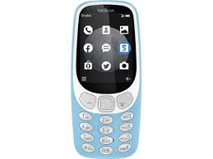
Will Starlink work with cell phones?
Your phone does not have enough power to beam a signal up to LEO where the satellites are, so your phone by itself cannot connect to the network. ... Starlink isn't intended to work that way, but Iridium phones work just fine. It's all about power levels and the frequency of the signal, not just the orbit.

Slide 13
How can I access free internet?
Steps
Search for free Internet on a hotspot database. ...
Use your phone's data as a hotspot. ...
Check to see if your cable company offers free hotspots.
Use a free trial Internet service. ...
Exchange chores for Internet access. ...
Find a local store or business in which to work. ...
Look for Wi-Fi while you wait.

Slide 14
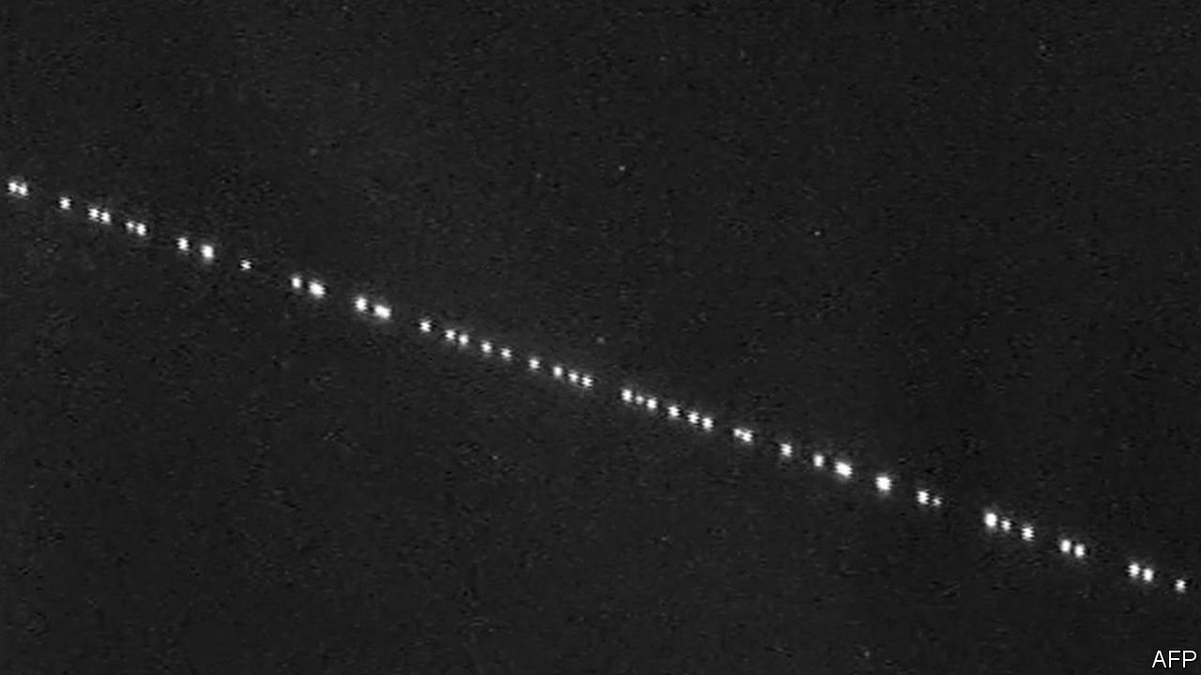
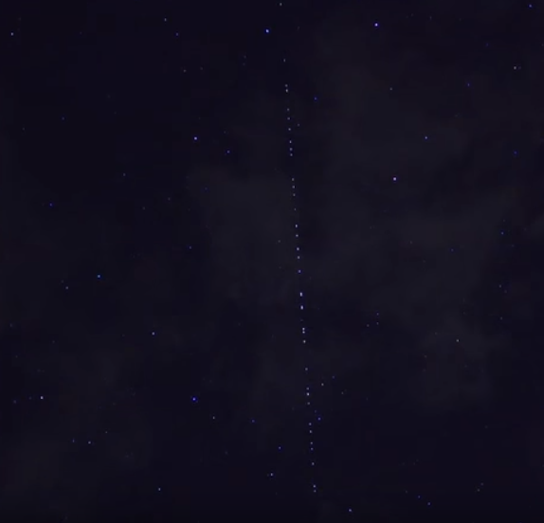
Can We see starlink?

Slide 15
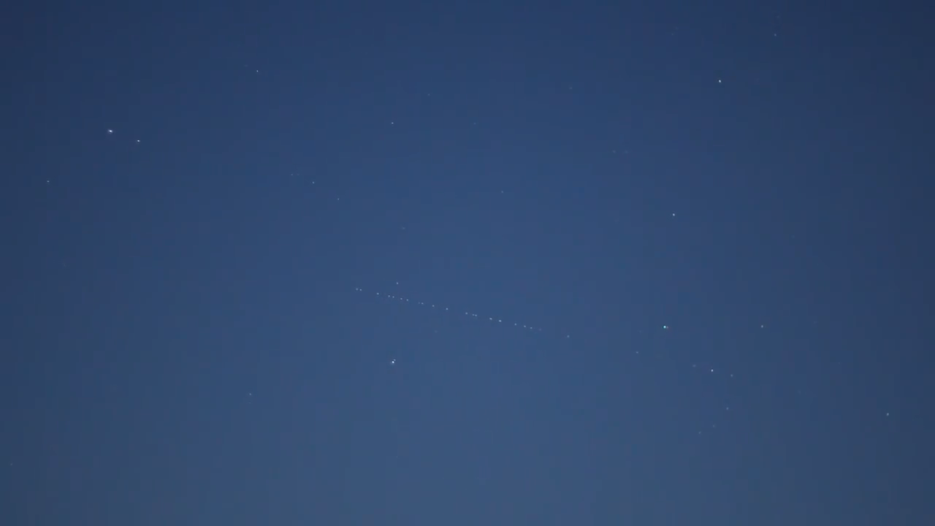
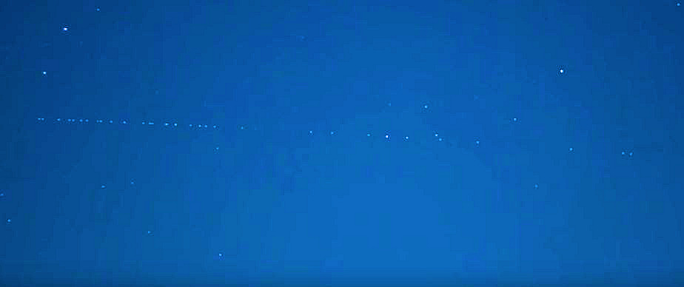
https://www.youtube.com/watch?v=T6v47CmRA7A

Slide 16

